Slide 1
Today‘s Agenda
Combinational Circuit Analysis

Slide 2
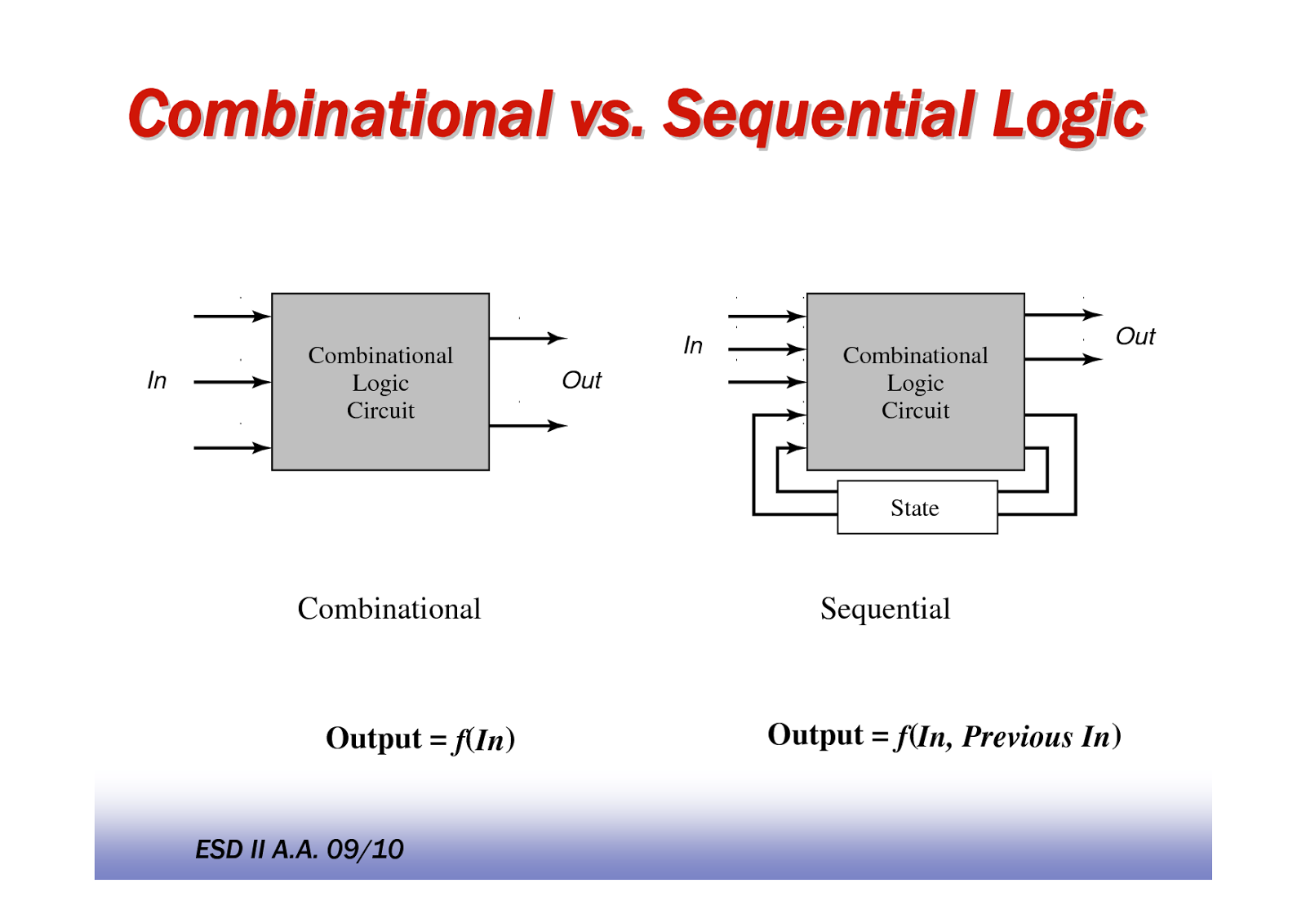
Types of Logic Circuits
Combinational
Sequential
Present combination of I/ps
Present combination of I/ps + Past sequence of I/ps
O/p depends on
Elements involved
Logic gates
Logic gates + Storage elements
Feedback present?
No
Yes

Slide 3
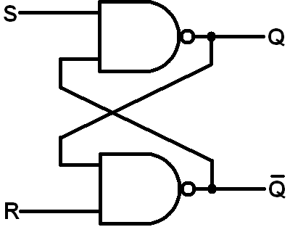
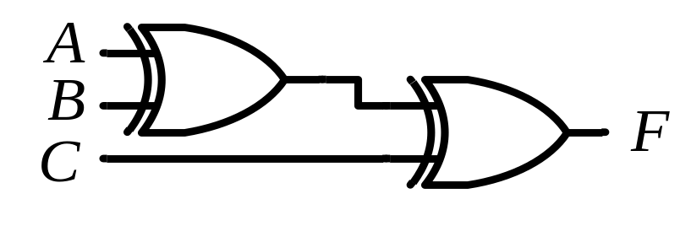
Types of Logic Circuits
Combinational
Sequential
Example
NOT for understanding

Slide 4

Combinational Circuit
Combinational
Circuit
n inputs
m outputs
•
•
•
•
•
•
✗

Slide 5


Combinational Circuit
Examples
1
0
1
0
1
0
1
0
0
Even number of ‘1’s
Parity Generator
1
0
1
0
0
Error
Check
Parity Checker

Slide 6
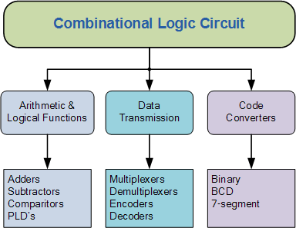
Combinational Circuit

Slide 7
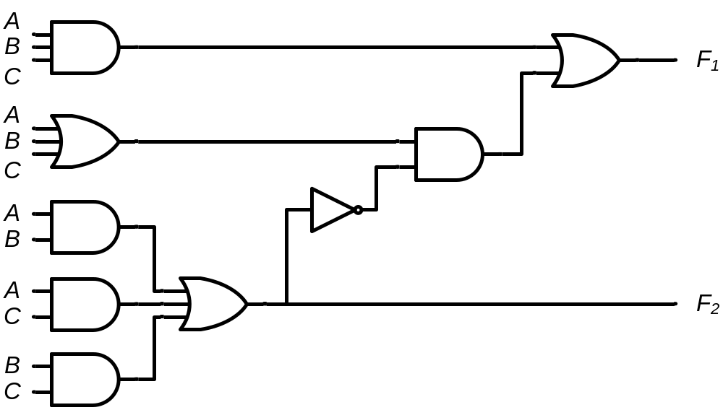
Comb. Circuits: Analysis V/s Design
Analysis
  Given a circuit, find out its function
  Function may be expressed as:
    Boolean function
    Truth table
Design
  Given a desired function/specifications, determine its circuit
  Function may be expressed as:
    Boolean function
    Truth table
?
?
?

Slide 8
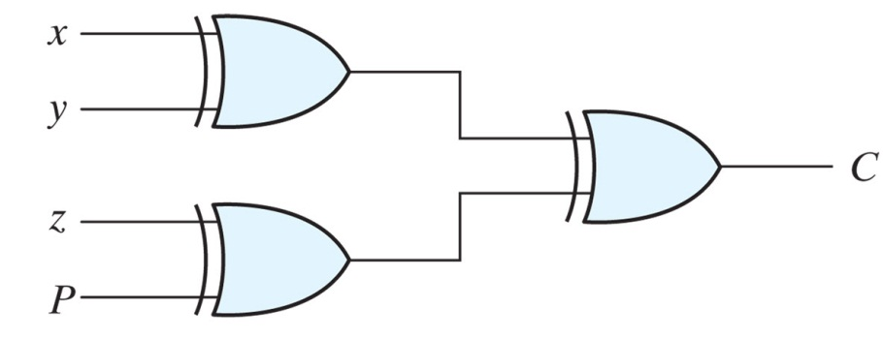

Comb. Circuits: Analysis Procedure
Two approaches:
  Boolean Function:
  Write the O/p equation describing behavior of the circuit in terms of its I/p(s)
  Truth Table:
  Create a truth table which shows relationship between circuit inputs and circuit outputs
Example

Slide 9
Analysis @ Boolean Function
Example
F₁ = ?
F₂ = ?
Label all gate O/ps that are a function of I/p variables

Slide 10
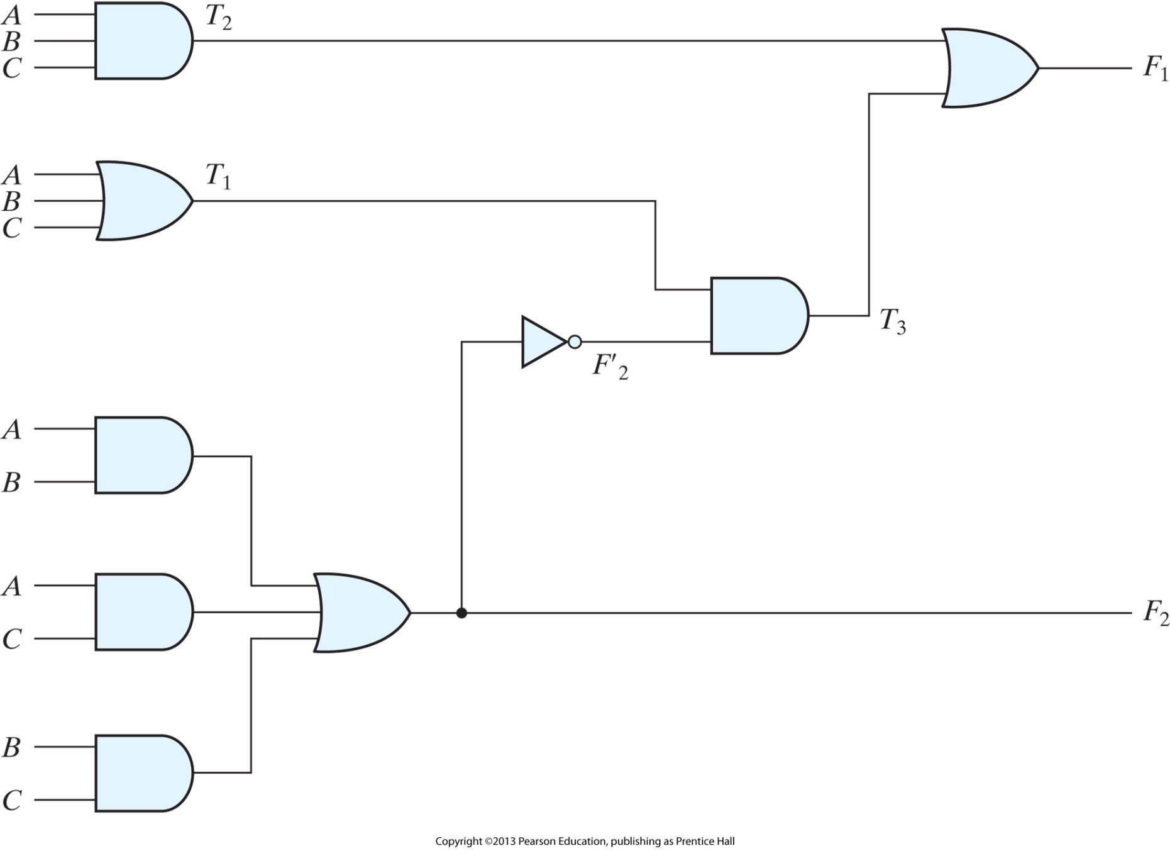
Analysis @ Boolean Function
Solution

Slide 11
Analysis @ Boolean Function
Solution
T₂ = ABC
T₁ = A+B+C
T₃ = F’₂T₁
F’₂ = (A’+B’)(A’+C’)(B’+C’)
F₂ = AB+AC+BC
Write the Boolean expressions

Slide 12
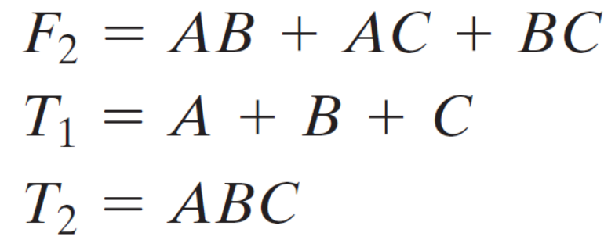
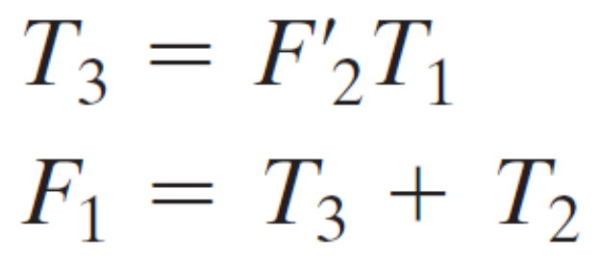
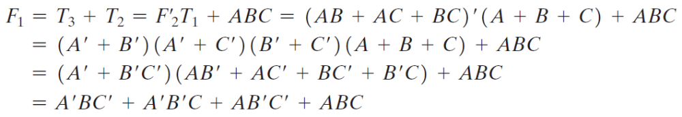
Analysis @ Boolean Function Approach
Solution

Slide 13
Comb. Circuits: Analysis Procedure
Truth Table
  Determine the number of I/p variables (n) in the circuit (2^{n} combinations). List the binary numbers from 0 to (2^{n} - 1)
  For each combination of I/p, find the O/p based on the given circuit
  Fill all the truth table

Slide 14
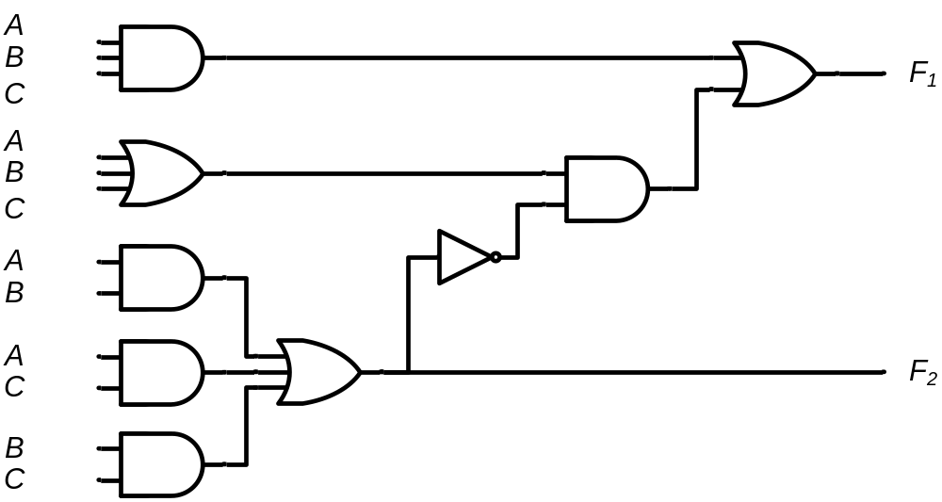
Analysis @ Truth Table Approach
A B C | F₁ | F₂
0 0 0
= 0
= 0
= 0
= 0
= 0
= 0
= 0
= 0
= 0
= 0
= 0
= 0
0 0
0
0
0
0
0
0
0
1
0

Slide 15
Analysis @ Truth Table Approach
A B C | F₁ | F₂
0 0 0 | 0 | 0
0 0 1
= 0
= 0
= 1
= 0
= 0
= 1
= 0
= 0
= 0
= 1
= 0
= 1
0
1
0
0
0
1
1 0
1
1
0

Slide 16
Analysis @ Truth Table Approach
A B C | F₁ | F₂
0 0 0 | 0 | 0
0 0 1 | 1 | 0
0 1 0
= 0
= 1
= 0
= 0
= 1
= 0
= 0
= 1
= 0
= 0
= 1
= 0
0
1
0
0
0
1
1 0
1
1
0

Slide 17
Analysis @ Truth Table Approach
A B C | F₁ | F₂
0 0 0 | 0 | 0
0 0 1 | 1 | 0
0 1 0 | 1 | 0
0 1 1
= 0
= 1
= 1
= 0
= 1
= 1
= 0
= 1
= 0
= 1
= 1
= 1
0
1
0
0
1
0
0
0 1
0
1

Slide 18
Analysis @ Truth Table Approach
A B C | F₁ | F₂
0 0 0 | 0 | 0
0 0 1 | 1 | 0
0 1 0 | 1 | 0
0 1 1 | 0 | 1
1 0 0
= 1
= 0
= 0
= 1
= 0
= 0
= 1
= 0
= 1
= 0
= 0
= 0
0
1
0
0
0
1
1
1
1 0
0

Slide 19
Analysis @ Truth Table Approach
A B C | F₁ | F₂
0 0 0 | 0 | 0
0 0 1 | 1 | 0
0 1 0 | 1 | 0
0 1 1 | 0 | 1
1 0 0 | 1 | 0
1 0 1
= 1
= 0
= 1
= 1
= 0
= 1
= 1
= 0
= 1
= 1
= 0
= 1
0
1
0
1
0
0
0
0
0 1
1

Slide 20
Analysis @ Truth Table Approach
A B C | F₁ | F₂
0 0 0 | 0 | 0
0 0 1 | 1 | 0
0 1 0 | 1 | 0
0 1 1 | 0 | 1
1 0 0 | 1 | 0
1 0 1 | 0 | 1
1 1 0
= 1
= 1
= 0
= 1
= 1
= 0
= 1
= 1
= 1
= 0
= 1
= 0
0
1
1
0
0
0
0
0
0 1
1

Slide 21
Analysis @ Truth Table Approach
A B C | F₁ | F₂
0 0 0 | 0 | 0
0 0 1 | 1 | 0
0 1 0 | 1 | 0
0 1 1 | 0 | 1
1 0 0 | 1 | 0
1 0 1 | 0 | 1
1 1 0 | 0 | 1
1 1 1
= 1
= 1
= 1
= 1
= 1
= 1
= 1
= 1
= 1
= 1
= 1
= 1
1
1
1
1
1
1
0
0
1
1 1
 |  |  |  | B
 |  | 0 | 1 | 0 | 1
A |  | 1 | 0 | 1 | 0
 |  |  | C
 |  |  |  | B
 |  | 0 | 0 | 1 | 0
A |  | 0 | 1 | 1 | 1
 |  |  | C
F₁ = AB'C‘ + A'BC‘ + A'B'C + ABC
F₂ = AB + AC + BC

Slide 22


Analysis @ Boolean Function
Solution
F₂ = 1 for any combination
that has two or three I/ps = 1
T₂ = AND of I/p Combinations
T₁ = OR of I/p Combinations
T₃ = 1 iff T₁ = 1 AND F’₂ = 1
F₁ = 1 if T₂ = 1 OR T₃ = 1
A B C
0 0 0
0 0 1
0 1 0
0 1 1
1 0 0
1 0 1
1 1 0
1 1 1
F₂
0
0
0
1
0
1
1
1
F’₂
1
1
1
0
1
0
0
0
T₂
0
0
0
0
0
0
0
1
T₁
0
1
1
1
1
1
1
1
T₃
0
1
1
0
1
0
0
0
F₁
0
1
1
0
1
0
0
1

Slide 23
Design of Combinational Circuits:
From Specifications, determine the required number of inputs and outputs
Assign a variable to each input and output
Derive a truth Table that defines the required relationship between inputs and outputs
Perform logic minimization
Draw the logic diagram

Slide 24
Example:
Design a combinational circuit with three inputs x,y,z and three outputs A,B and
C. When the binary input is 0,1,2 or 3 the binary output is two greater than the
Input. When the binary input is 4,5,6 or 7 the binary output is three less than the
Input.

Slide 25
Example:
Design a digital circuit with the output f and inputs A,B,C and D. Let the two inputs AB represent a two bit number with A as the high order bit, and CD represent another two bit number. That is, the values on AB represent four values 00 (0), 01 (1), 10 (2), and 11 (3). The output ‘ f ’ should be 1 only if the number represented by AB is greater than or equal to the number represented by CD.

